Slide 1
Educational Audiology Value and Role - Lecture 1
‘BSA Grow’ Online Course brought to you by:
British Association of Educational Audiologists (BAEA) NEC
Paediatric Audiology interest Group (PAIG), BSA
Dr Joy F Rosenberg
Mary Hare partnered with University of Hertfordshire
Notes:
I am used to more interactive presentations, thus explore and discuss appear as LO’s, so will attempt to give some pauses for your own reflections.
I assume my audience is largely clinicians and thus address it so, but appreciate there will be people in other roles joining the course as well.
Abbreviation 'Ed Aud' will be used throughout.

Slide 2
Rate your current understanding
Image from Remmont.com

Slide 3
Learning Objectives
Explore liaison between Educational and Health Audiology and its benefit to outcomes
Examine roles and competencies of Educational Audiology
Discuss history of Educational Audiology
Review training route for Educational Audiology

Slide 4
Notes:
Picture is worth a thousand words, so will give this a moment for your to peruse.
Clinicians and educaitonal audiologists working together have the best opportunity to fully understand what its listening life is like outside the clinic.
enables clinicians to more readily monitor ‘real-life’ functional benefit of hearing instrument (HI) fittings when patients are outside the clinic, providing more robust validation and potentially saving clinic time.

Slide 5
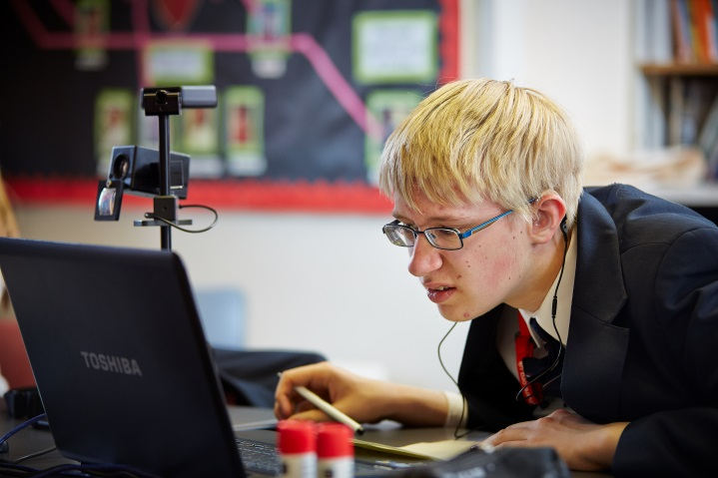
The Heart of Educational Audiology
Partnering Education, Health, Families and Technology
To ‘Secure the future for children and young people who are deaf’

Slide 6
Heads of Service Survey Responses
In regards to the Ed Aud role include:
vital and crucial in maintaining the integrity of the service
key to accessing new information to share with colleagues
essential to the services of children and young people who are deaf and their families’

Slide 7
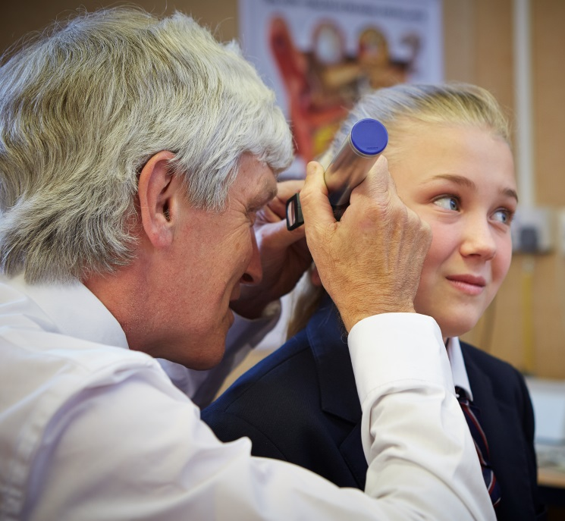
History of the role
Educational Audiologist (Ed Aud) role beginnings in 1970 with Education Act
Only course in UK, possibly Europe
Different model to other countries
Based on Roles and Competencies from BAEA
Endorsed by BAEA and by BAA
Accredited by RCCP for voluntary professional registration of graduates
Course at Mary Hare partnered to university since 1990’s
Notes:
The first-ever voluntary professional registration for Educational Audiologists with the Registration Council for Clinical Physiologists (RCCP) was announced in June 2018. significant contribution to clinical services improving local quality across the UK. This registration improves joined-up audiology working between Health and Education which
The Education Act (handicapped children) 1970 transferred all of the Health staff working with supposedly ‘ineducable’ children to the responsibility of Education Departments:
1 (2) The Secretary of State shall by order make such provision as appears to him to be necessary or expedient in consequence of subsection (1) above—
(a) for the transfer to the employment of local education authorities of persons employed by local health authorities (not being also local education authorities) or by regional hospital boards; and
(b) for the protection of the interests of persons who before the appointed day have been employed for the purpose of functions of local health authorities (including those functions of authorities which are also local education authorities) or functions of regional hospital boards; and
(c) for the transfer to local education authorities of property, rights and liabilities of local health authorities or regional hospital boards.
Peter Keen (BAEA Chair ??????) points out that this above extract from the Act appears to say that the Education Authority was taking over the responsibility for not only employing the specialists previously employed by Health but also the responsibility of maintaining the services previously provided by Health - ie all the services previously provided by the Paediatric Audiologists. This would mean that the requirement to provide the mandatory service was transferred as well as the person (the Educational Audiologist) who provided it.
This Act included all of the ‘Pre-School’ or ‘Paediatric’ Audiologists who previously worked in hospital Audiology departments providing the Children’s Tier 2 and Tier 3 diagnostic clinics (babies and children) for deafness, clinics for fitting hearing aids and reviewing these hearing aids as well as reviewing hearing. They also provided the ‘home visiting’ for pre-school children to support the parents and provide educational input and hearing aid habituation on a regular basis. They were also the specialists in the school-age clinics reviewing hearing and hearing aids.
The specialist qualification (MSc or Diploma in Educational Audiology now provided by University of Hertsfordshire/Mary Hare) also includes measuring and reporting on Room Acoustics and using frequency-specific analysis of receptive and expressive speech to review hearing aid provision among other innovations relevant to the specialist role.
Thus Local Authorities conforming to the original requirements of the 1970 Act employ specialist professionals - the Educational Audiologists - who are involved in the diagnosis, selection and review of hearing aid (in or liaising with the Hospital’s Audiology dept), the advice being given to family and school and the assessment of educational progress related to the child’s audiological status and learning environment. Measuring and reporting on the acoustics of learning areas and provision of Radio/Digital/FM Hearing Aids are also part of this specialism.

Slide 8
Roles and Competencies British Association of Educational Audiologists (BAEA)
BAEA Major Role Areas:
1. Child and Family Support
2. Educational assessment, advice to schools and inclusion.
3. In-service training
4. Educational Amplification Systems.
5. Professional contribution to the multi-professional team.
6. Audiological Testing
7. Selection, Verification & Evaluation of Hearing Instruments.
For detail see: http://www.educational-audiologists.org.uk/documents.php
Notes:
empowers clinicians’ holistic partnership-working in terms of opening the auditory ‘doorway to the brain’ with impact on language, cognitive and social development contributing to literacy and well-being.

Slide 9
Educational Audiology varied roles across the UK
Job titles
Organizational charts
Employers
(both Education and Health)
Notes:
The questions asked were:
Are you currently employed as an Educational Audiologist? – please give your job title
If you are currently employed as a Teacher of the Deaf and not as an Educational Audiologist, is this because your Educational Audiology role was changed or was the job of Teacher of the Deaf also in the original job spec/title?
Do you do Educational Audiologist work but are paid only as a Teacher of the Deaf?
Is your role as Educational Audiologist full time or part time. If you are able please give a brief outline of your current responsibilities.
Where have you been essential in the support of deaf children under your care and what did you do?
What would the consequence to that deaf child or those children have been if you had not provided the service you did?
(1) Job titles vary for those qualified as Educational Audiologist from Inclusion Teacher, Teacher of the Deaf, Paediatric, Educational Audiologist, Advisory Teacher for Children with Hearing Impairment and Educational Audiologist, to Assistant Team Leader for School Sensory Support and Team Leader (Hearing Impairment Peripatetic)
(2) There seems to be a common trend in that Educational Audiologists are either a Teacher of the Deaf with responsibility for Educational Audiology or that they become part of the leadership teams of services but still retain the responsibility for the Educational Audiology role for services.
‘TOD original and then changed to be ed aud as well when qualified’
‘Was Employed as a ToD/trainee Ed Aud initially’
‘After qualifying as an EA my job title has remained the same. (Our service has been going through the commissioning process during which no changes were possible to job roles, although I have been working as an EA).’
‘Originally employed as a TOD but asked to do the Ed Aud qualification. I was given a day a week for audiology related matters but that was squeezed as our capacity diminished and now I fit it all in when I can’
‘I do EA work – but I’m paid on Leadership’
The implications for this are huge in that there is less time and therefore the skills are more thinly spread. The questionnaire highlighted that some Educational Audiologists are leaving the profession because of these changes:
For the last two years my title has been to Assistant Team Leader for School Sensory Support. Before the changes I had been Team Leader of a team of 5 Educational Audiologist. As a result of the restructure I am the only Educational Audiologist remaining, the other 4 were allocated to other areas. 3 of these have now resigned/retired. The other remains an Educational Audiologists but also a Team Leader for the hearing Impaired Team.
(3) Some Educational Audiologists are employed and paid by NHS trusts as Audiologists, however the majority seem to be employed in education and are therefore are under teachers pay and conditions. A few it would seem do get recognition of their Educational Audiology role and receive a Teaching and Learning Responsibility (TLR) point (but not all!). Educational Audiologist by definition start as Teachers of the Deaf, however as they are often in the Teacher of the Deaf role when they train, unless it has been agreed then they do not always get an increase in their salary, just an increase in their responsibilities.
(4) There are Educational Audiologists who work in health supporting families with hearing impaired babies until they are 2 years old, this is an unusual but commendable role. Others (most) who have split roles can only then, have a part time commitment to the Educational Audiology role:
‘I am only able to do 2 days because of my management responsibilities. ‘
‘My Educational Audiology role is part time as I am mainly a Teacher of the Deaf.’
‘I work full time and cover both roles difficult to split the 2 for me but ~1 day per week Ed Aud’
And then there are those who are Educational Audiologist but are not employed in that role:
‘Am not employed as Ed Aud, though the fact that I have that qualification and experience in the past informs my current practice as TOD’

Slide 10
BAEA statement: Ed Auds Adding value
Unique combo of knowledge and skills (e.g., language and auditory skills development; speech discrimination; speech, room and psycho-acoustics; assistive technology: radio aids, soundfield systems, hearing aids and auditory implants/ implanted aids.)
Interplay of listening and technology with child development
Unique liaison between Health and Education
Working routinely across age range of birth to 25 years
Considered ‘essential’ by many services
As a minimum every service should have provision of an Ed Aud for all CYPs with severe or profound hearing loss.
Notes:
Surrey –Now aware of what clinic needs and explaining to parents. Able to refresh audiology skills for veteran ToDs. Some think only distinction is providing FM, but priors HoS knew the value.
Oxon – knowledge of tech: radio system and soundfield. Can network with and question manufacturers and therefore save money.
Exeter – As ToD lost audiology skills from MQ training, because they weren’t used, and focused on curriculum.
Mill Hall – much more curriculum driven in a special school, or perhaps resource unit placement. If peripatetic, then more language and audiology driven. Bridging understanding with Health of educational issues related to hearing.
Leicester – Have better capacity due to deeper understanding. More empowerment for NHSP. Knowledge about wider range of conditions. More skill with getting results from children. More contact with parents over systems. More authority to go to schools with evidence and support teachers and parents. Get very good feedback from parents. Now designing protocols together with Health
Yorkshire – Tods now upskilled and equipment bought knowledgeably. Acoustic checks protocols. Better outcomes for children
Kent – Asked by Audio-vestibular physician to be liaison with ToD over particular issue
Stafford – Huge impact on ToD daily practice, impacting access to curriculum and inclusion
N Ireland;
The course has changed Wendy’s practice and the role of educational audiologist has added value as an essential bridge between Education, Audiology and working in partnership with parents. The education service works as a real team with audiology clinics now. In the past, there was liaison between them, but now there are stronger working relationships, confidence in each discipline’s professionalism, and mutual trust that identifying gaps is not about criticism but about improving practice for families of children who are deaf. There is a renewed drive to review and update practice and policies (e.g. working in partnership and informed choice) in both Education and Audiology and to see what can be done better. Now joint education and audiology clinics are held with ToDs more confident about their audiology skills, and awareness raising training is provided to Educational Psychologists. As an Educational Audiologist, Wendy is in a stronger position to provide strategic advice to the restructured authority, particularly following newborn hearing screening. Personally, her studies have also made her a more reflective practitioner. The Educational Audiology role has become an essential link for families who are dealing with many professionals to help them make sense of all the support and to empower them to help their own child’s development. Most importantly, parents are beginning to notice and appreciate the joined-up working.

Slide 11
Value of Ed Aud role Graduates’ perspectives
“Being on the Ed Aud course has opened more avenues and doors than I could have done with my previous training alone, having worked in the field for many years.”
The most valuable have been :
1. Cost savings
More collaboration on suitable purchases, networking with manufacturers and clinical audiologists
In-house training – upskilling and cascading
And……
Notes:
Surrey –Now aware of what clinic needs and explaining to parents. Able to refresh audiology skills for veteran ToDs. Some think only distinction is providing FM, but priors HoS knew the value.
Oxon – knowledge of tech: radio system and soundfield. Can network with and question manufacturers and therefore save money.
Exeter – As ToD lost audiology skills from MQ training, because they weren’t used, and focused on curriculum.
Mill Hall – much more curriculum driven in a special school, or perhaps resource unit placement. If peripatetic, then more language and audiology driven. Bridging understanding with Health of educational issues related to hearing.
Leicester – Have better capacity due to deeper understanding. More empowerment for NHSP. Knowledge about wider range of conditions. More skill with getting results from children. More contact with parents over systems. More authority to go to schools with evidence and support teachers and parents. Get very good feedback from parents. Now designing protocols together with Health
Yorkshire – Tods now upskilled and equipment bought knowledgeably. Acoustic checks protocols. Better outcomes for children
Kent – Asked by Audio-vestibular physician to be liaison with ToD over particular issue
Stafford – Huge impact on ToD daily practice, impacting access to curriculum and inclusion
N Ireland;
The course has changed Wendy’s practice and the role of educational audiologist has added value as an essential bridge between Education, Audiology and working in partnership with parents. The education service works as a real team with audiology clinics now. In the past, there was liaison between them, but now there are stronger working relationships, confidence in each discipline’s professionalism, and mutual trust that identifying gaps is not about criticism but about improving practice for families of children who are deaf. There is a renewed drive to review and update practice and policies (e.g. working in partnership and informed choice) in both Education and Audiology and to see what can be done better. Now joint education and audiology clinics are held with ToDs more confident about their audiology skills, and awareness raising training is provided to Educational Psychologists. As an Educational Audiologist, Wendy is in a stronger position to provide strategic advice to the restructured authority, particularly following newborn hearing screening. Personally, her studies have also made her a more reflective practitioner. The Educational Audiology role has become an essential link for families who are dealing with many professionals to help them make sense of all the support and to empower them to help their own child’s development. Most importantly, parents are beginning to notice and appreciate the joined-up working.

Slide 12
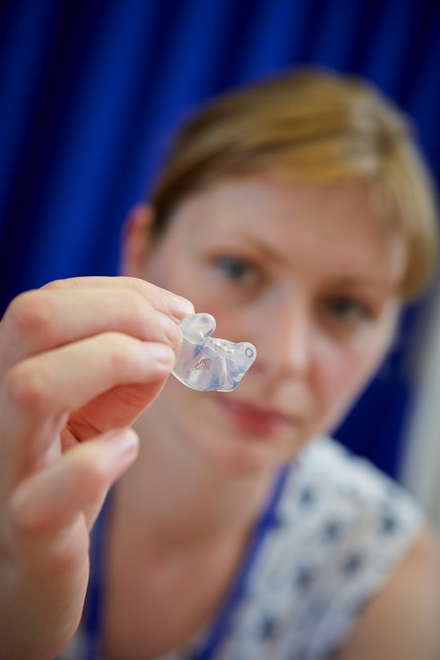
Graduates perspectives (cont’d)
2. Ed Aud provides better outcomes for children, young people and families due to
Liaison with Health
Benefits collaborative technology fit validation
Audiologist ‘on the literacy team’ (KEnglish 2012, Cflexer 2016) by virtue of hearing instruments opening doorway to the brain with speech and language development supporting literacy
Expertise and deeper knowledge
Source for parents, ToDs and Health; builds team confidence
Functional view aetiological impact such as ANSD
Technology – radio aids and sound field, verification and relationship to speech perception and functional hearing
Notes:
Surrey –Now aware of what clinic needs and explaining to parents. Able to refresh audiology skills for veteran ToDs. Some think only distinction is providing FM, but priors HoS knew the value.
Oxon – knowledge of tech: radio system and soundfield. Can network with and question manufacturers and therefore save money.
Exeter – As ToD lost audiology skills from MQ training, because they weren’t used, and focused on curriculum.
Mill Hall – much more curriculum driven in a special school, or perhaps resource unit placement. If peripatetic, then more language and audiology driven. Bridging understanding with Health of educational issues related to hearing.
Leicester – Have better capacity due to deeper understanding. More empowerment for NHSP. Knowledge about wider range of conditions. More skill with getting results from children. More contact with parents over systems. More authority to go to schools with evidence and support teachers and parents. Get very good feedback from parents. Now designing protocols together with Health
Yorkshire – Tods now upskilled and equipment bought knowledgeably. Acoustic checks protocols. Better outcomes for children
Kent – Asked by Audio-vestibular physician to be liaison with ToD over particular issue
Stafford – Huge impact on ToD daily practice, impacting access to curriculum and inclusion
N Ireland;
The course has changed Wendy’s practice and the role of educational audiologist has added value as an essential bridge between Education, Audiology and working in partnership with parents. The education service works as a real team with audiology clinics now. In the past, there was liaison between them, but now there are stronger working relationships, confidence in each discipline’s professionalism, and mutual trust that identifying gaps is not about criticism but about improving practice for families of children who are deaf. There is a renewed drive to review and update practice and policies (e.g. working in partnership and informed choice) in both Education and Audiology and to see what can be done better. Now joint education and audiology clinics are held with ToDs more confident about their audiology skills, and awareness raising training is provided to Educational Psychologists. As an Educational Audiologist, Wendy is in a stronger position to provide strategic advice to the restructured authority, particularly following newborn hearing screening. Personally, her studies have also made her a more reflective practitioner. The Educational Audiology role has become an essential link for families who are dealing with many professionals to help them make sense of all the support and to empower them to help their own child’s development. Most importantly, parents are beginning to notice and appreciate the joined-up working.

Slide 13
Graduates’ Perspective
3. Skilled and knowledgeable instructors guide learning of clear practical activities and coursework which was very applicable It enabled me to do my job well and reminded me about all the parts of the job I really enjoy.

Slide 14
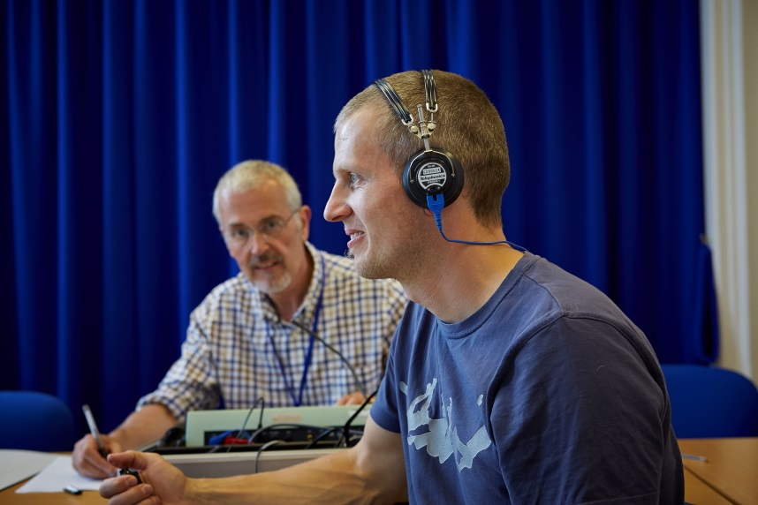
Educational Audiology graduates
Employed throughout UK
Also Ireland and Europe
Variety of roles
Likely to include:
Room acoustics
Complex needs
RA fitting
Advice to services
Close liaison with CYP, families, schools, clinics
HA and AI functional validation
May include
HA fitting and verification
Audiological Assessment
Notes:
These liaison issues have been evidenced empirically (cited in 2017 DfE Future of the Sector report) and anecdotally, presented at international conference, and featured in an upcoming BSA Grow e-module.

Slide 15
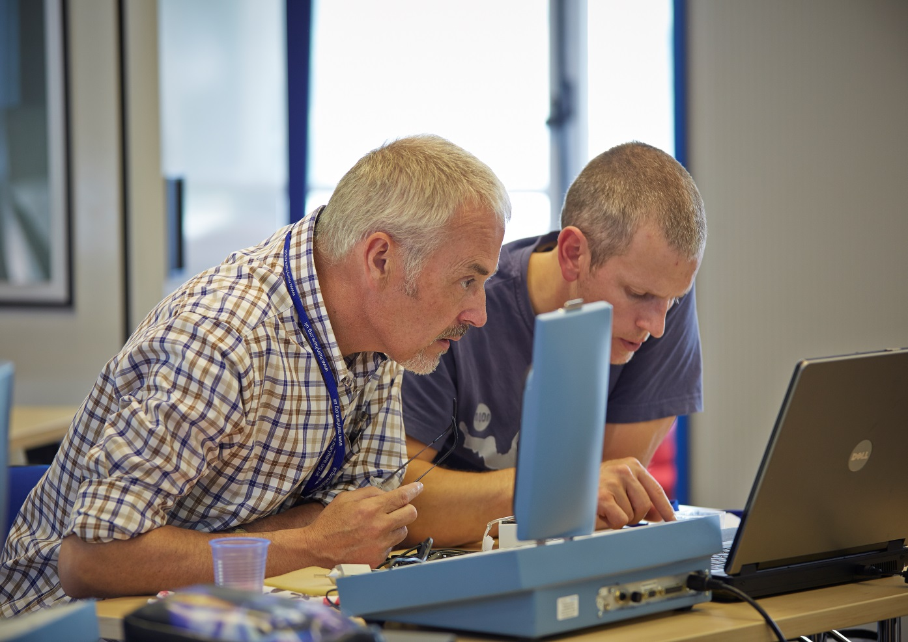
About the Training Course: Resources
Clinic and School Audiology Placements
HA and RA stock
Audiometers
Sound-proof booths
Electro-acoustic Test Boxes
Virtual Audiometry software
Access to HA programming
and REM
Specialist E-library
Virtual Learning Environment

Slide 16
Course QA processes
Programme Committee with Stakeholder, Student and Heads of Service feedback
CPD including peer review for Learning and Teaching
Annual module and programme evaluations
Exam Board and External Examiner
British Academy of Audiology (BAA) and BAEA endorsement
RCCP accreditation and professional registration
University six-yearly revalidation
Notes:
Registration is timely because of potential counter to fiscal threats to essential multidisciplinary liaison provided by Educational Audiologists.

Slide 17
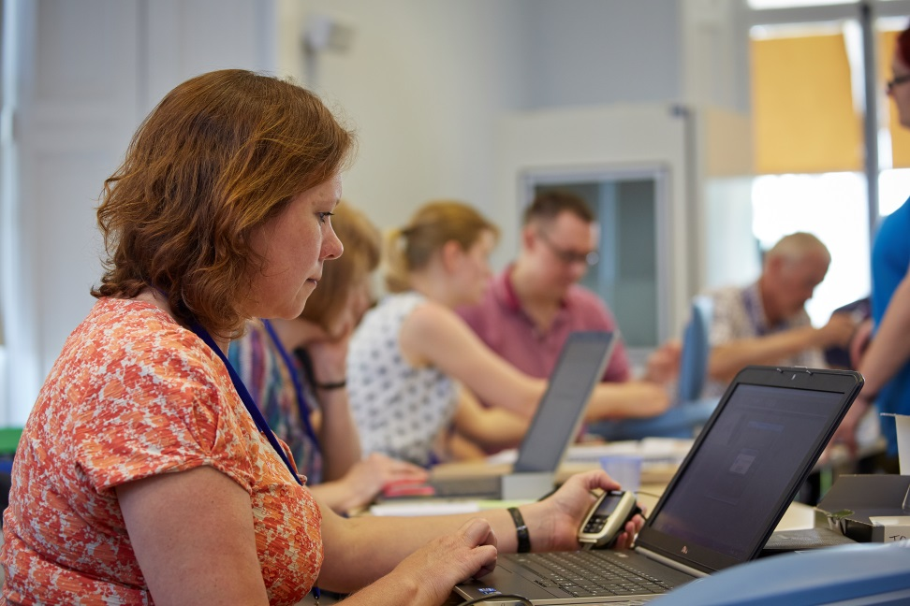
Course Structure
MSc/PGDip biennial intake
Stand-alone module options
In response to Professional Opinions Survey including Heads of Audiology service preferences for short-term CPD options
To further develop liaison between Health and Education who may train together on a stand-alone module
Notes:
Professional registration heralds new CPD options for clinicians in holistic HI validation via postgraduate stand-alone Educational Audiology modules. Registration and liaison efforts begun in the 1970’s have now been brought to fruition.

Slide 18
Module Topics
Anatomy and Physiology
Speech Acoustics
Clinical Audiology
Audiology in Educational Context
Development of Speech and Language (and relation to Literacy)
Psycho-acoustics
Whole Case Management
Multi-disciplinary and Family Friendly working
Research Methods and Dissertation

Slide 19
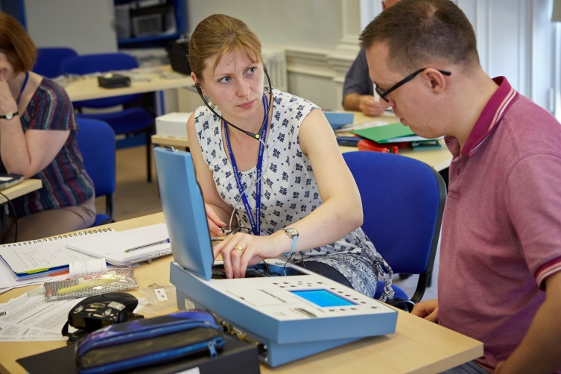
Faculty Programme and Course Leader: Joy Rosenberg, AuD Module Leader: Lisa Bull, MSc Educational Audiology
Tutors include well-experienced:
Teachers of the Deaf
Educational Audiologists
Speech Language Therapists
Clinical Scientists
Researchers
Guests including
Ed Psychs
Manufacturers
Parent Partners
Related areas

Slide 20
Further details
Please see websites: www.maryhare.org.uk/professional-courses/postgraduate-courses
www.herts.ac.uk/apply/schools-of-study/education/partnerships-in-education/uk-education-partners
Contact: courses@maryhare.org.uk or p.viney@maryhare.org.uk
Notes:
Cost for 2014-15
£3116 pa
£1873 for dissertation

Slide 21
Learning Objectives
Explore liaison between Educational and Health Audiology and its benefit to outcomes.
Examine roles and competencies of Educational Audiology
Discuss history of Educational Audiology
Review training route for Educational Audiology

Slide 22
Rate your current understanding
Image from Remmont.com

Slide 23
Images throughout from Mary Hare

Slide 24
Thank You
Dr Joy Rosenberg, PFHEA
Principal Lecturer
Programme Leader MA/MSc Deaf Ed Studies (ToD, Early Years and Ed Aud courses)
Teacher of the Deaf and Consultant Clinica Scientist -Audiology
j.rosenberg@maryhare.org.uk
www.herts.ac.uk/apply/schools-of-study/education/partnerships-in-education/uk-education-partners
www.maryhare.org.uk/professional-courses/postgraduate-courses

